Slide 1
Geostationary Cloud Tracking
Jonathan Kim, Kyler Norton, AJ Geckle

Slide 2
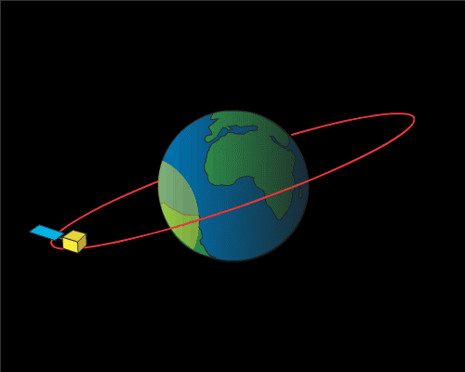
Geostationary Satellites
Geostationary satellites are in orbit about 22,000 miles above the Earth’s equator and spin at the same rate of the Earth
This allows them to continuously gather data from the same location on Earth
Notes:
Image Credits: https://www.weather.gov/about/satellites

Slide 3
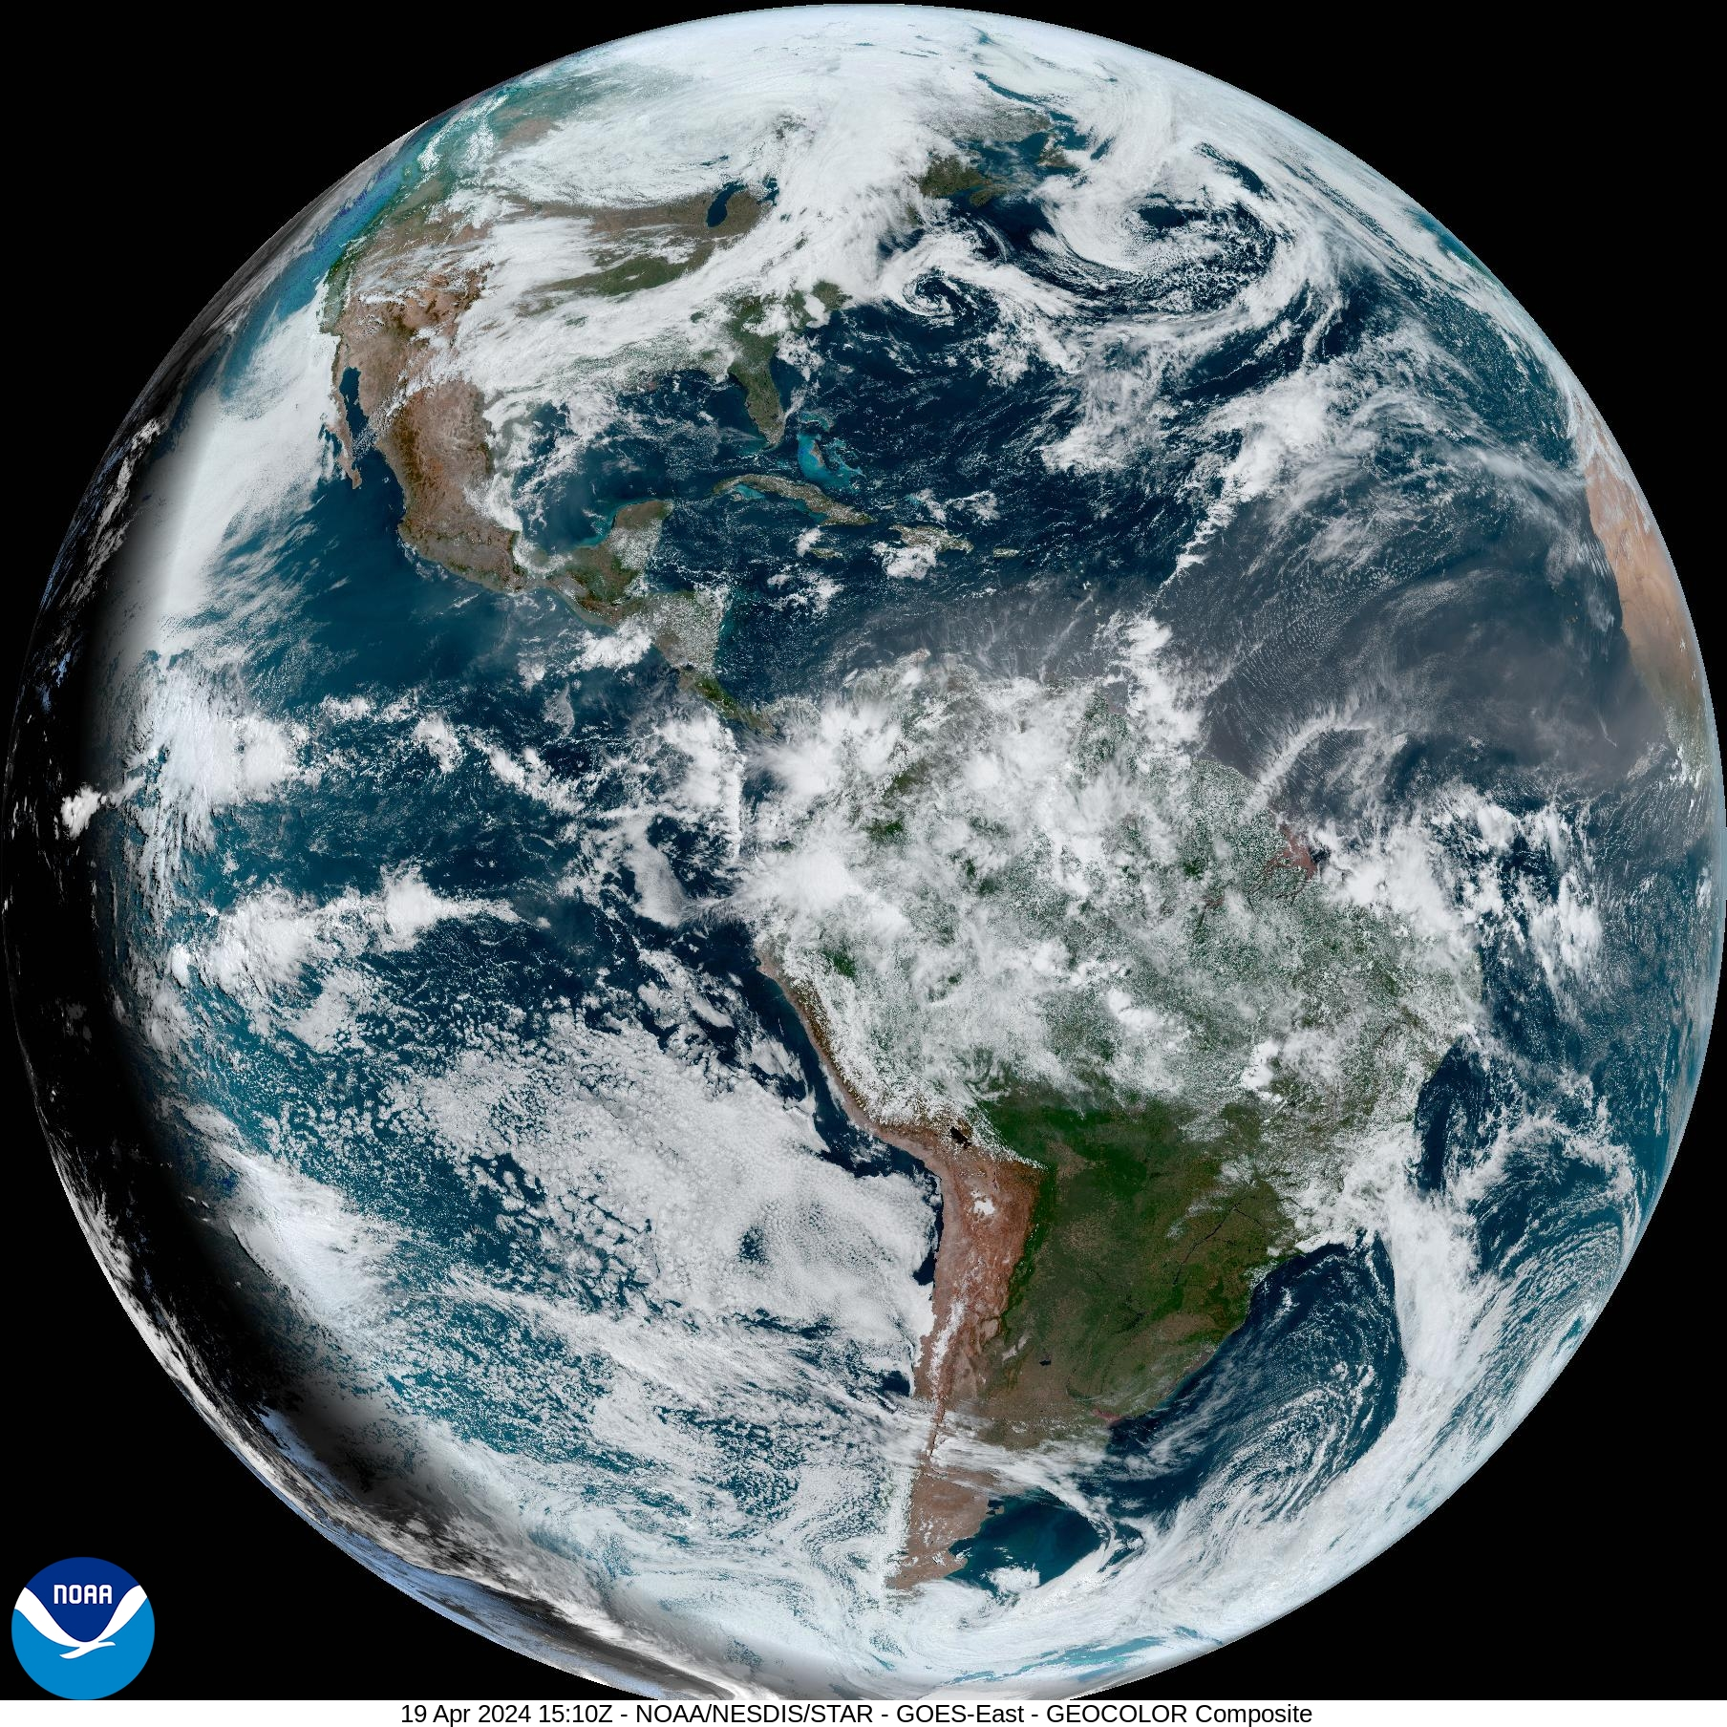
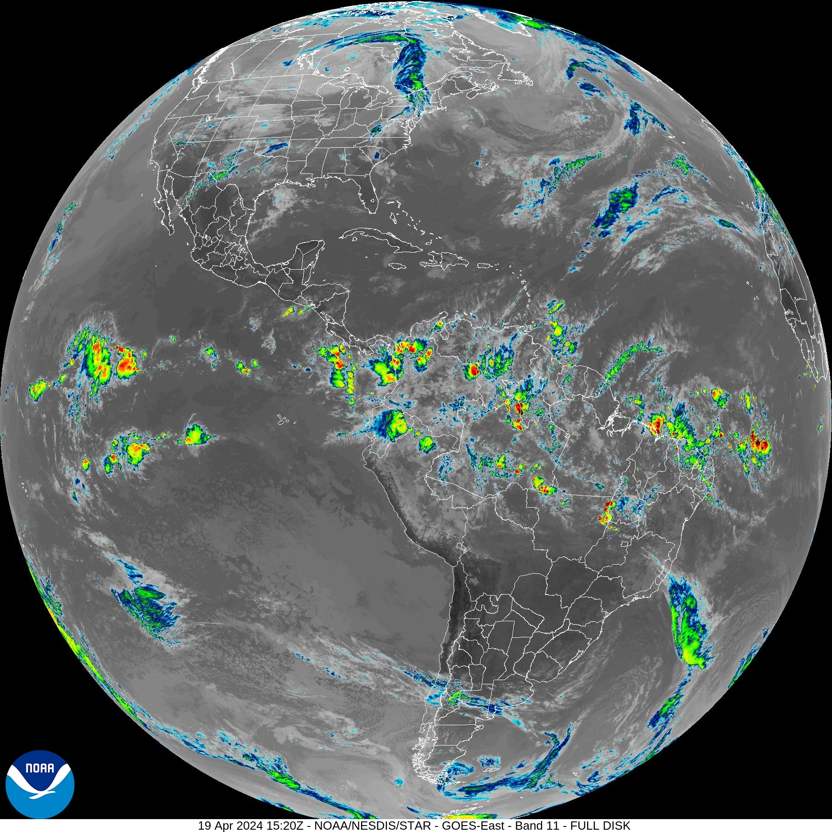
Background
Geostationary satellites take data about every 30 minutes under normal conditions
NOAA GOES-16 Satellite takes data every 10-15 minutes
Captures data across 16 visual/reflective, near-infrared, and infrared bands
Notes:
Image Credits: https://www.star.nesdis.noaa.gov/goes/fulldisk.php?sat=G16 (Taken April 19, 2024)

Slide 4
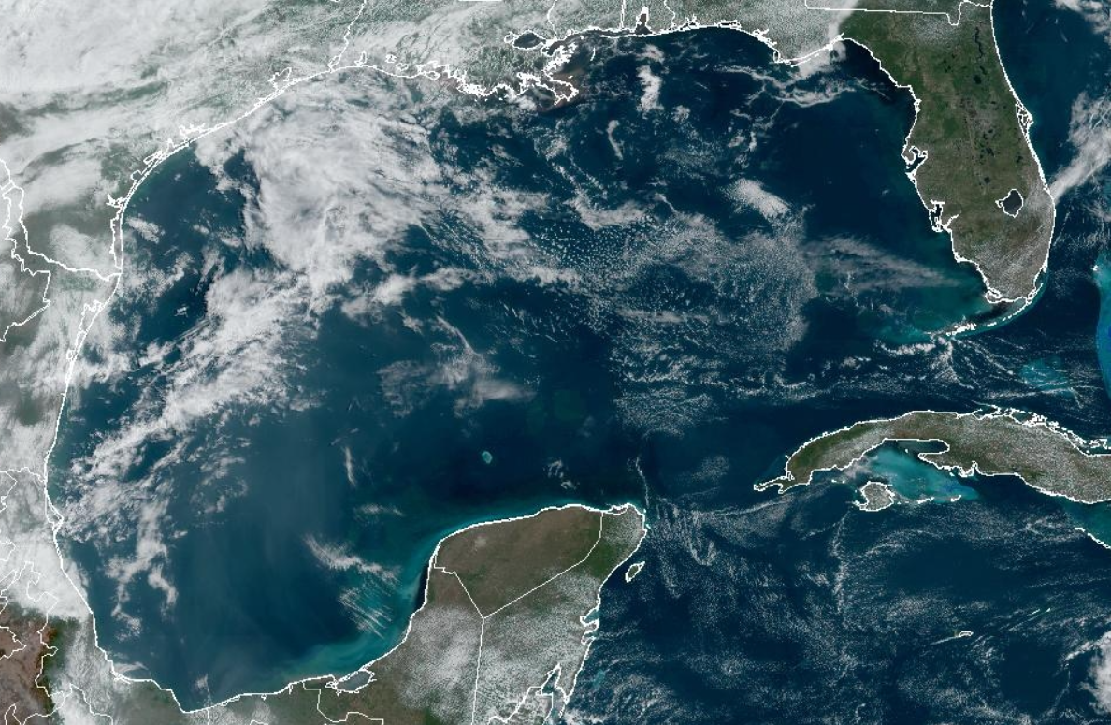
Goal
Use Machine Learning for cloud detection and tracking in the Gulf of Mexico using NOAA’s Geostationary Operational Environmental Satellite GOES-16
Notes:
Image Credits: https://www.star.nesdis.noaa.gov/goes/sector.php?sat=G16&sector=gm

Slide 5
Objectives
Create a predictive model that can fill in the missing satellite information between snapshots
Then use predictive model for future cloud movement prediction
Notes:
Image Credits: https://www.star.nesdis.noaa.gov/goes/sector.php?sat=G16&sector=gm

Slide 6
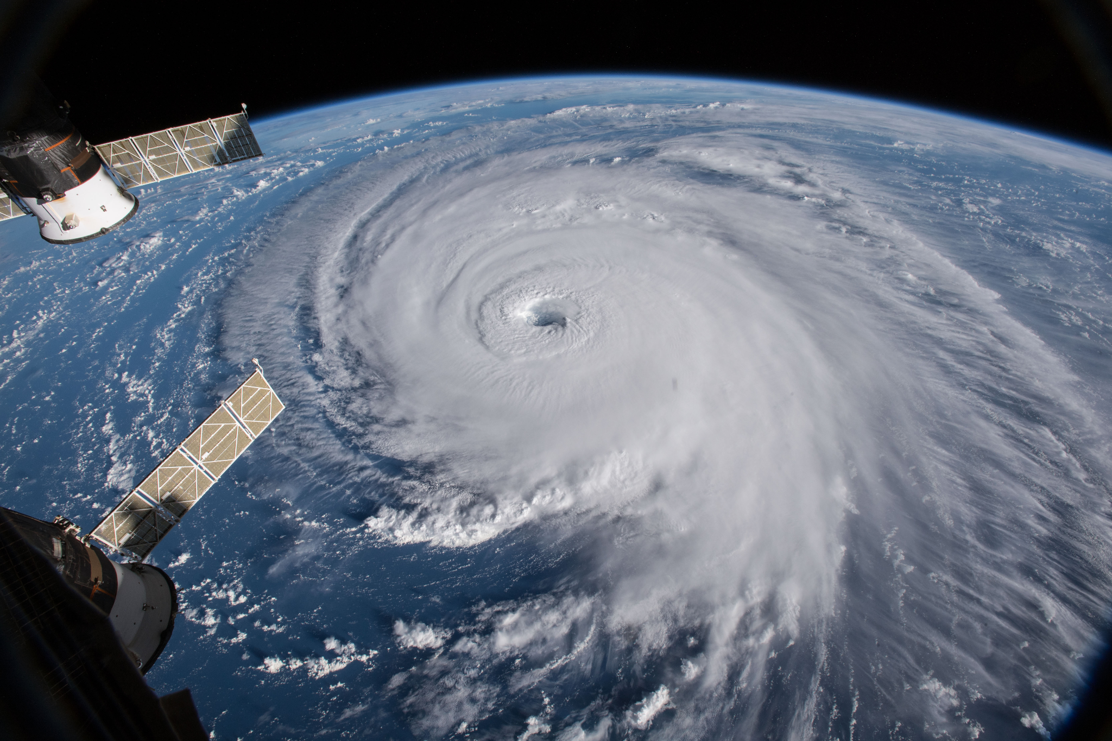
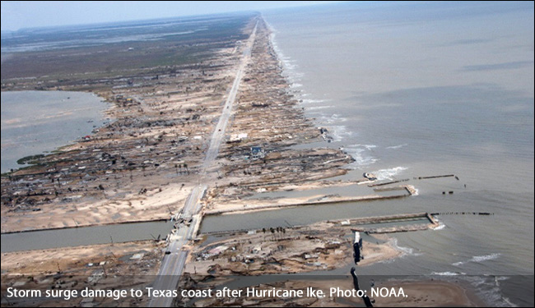
Project Motivation
Fill in missing satellite data for more accurate weather modeling and forecasting
Use this to track hurricanes to warn people sooner of the hurricane’s path
Notes:
Image Credits:
https://en.wikipedia.org/wiki/Tropical_cyclone
https://en.wikipedia.org/wiki/Atlantic_hurricane
(Links accessed May 2024)

Slide 7
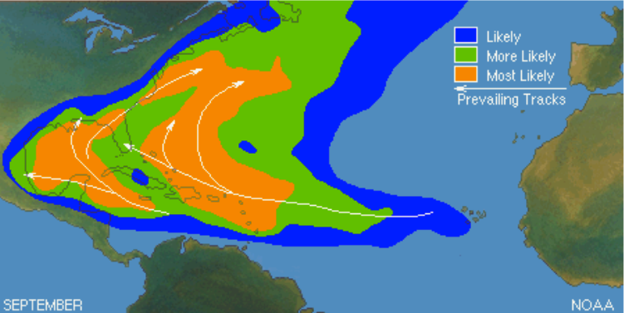
Why the Gulf of Mexico?
Hot spot for hurricanes
Hurricanes “funnel” through Mexico and Cuba
GOES-16 only takes images of the Western Hemisphere
Notes:
Image Credits: https://www.actionnews5.com/2019/07/29/breakdown-why-more-hurricanes-form-gulf-coast-august/

Slide 8
Data Pipeline
Satellite Images
Get satellite images

Slide 9
Earth Engine Code Editor
Pre-processing was initially done in the Earth Engine Code Editor, a Javascript web-based IDE for the Earth Engine API
Integrated data catalog: Direct access to large catalog of satellite imagery and geospatial datasets allowing easy implementation of GOES or SENTINEL-2 imagery preprocessing.
Scalability: GEE Platform handles computational load on Google servers
Real-time data access: Beneficial for time-sensitive projects like monitoring current tropical storm movement

Slide 10
Google Colab
Pre-processing was eventually moved to Google Colab
Machine Learning Library Support: Python supports all popular machine learning libraries such as TensorFlow, PyTorch, and Keras
Improves Exporting Time: Easier and more efficient to import/export data directly within Google Drive

Slide 11
Data Pipeline
GOES East Images
Receive GOES East images
Extraction Method
Extract clouds
+

Slide 12
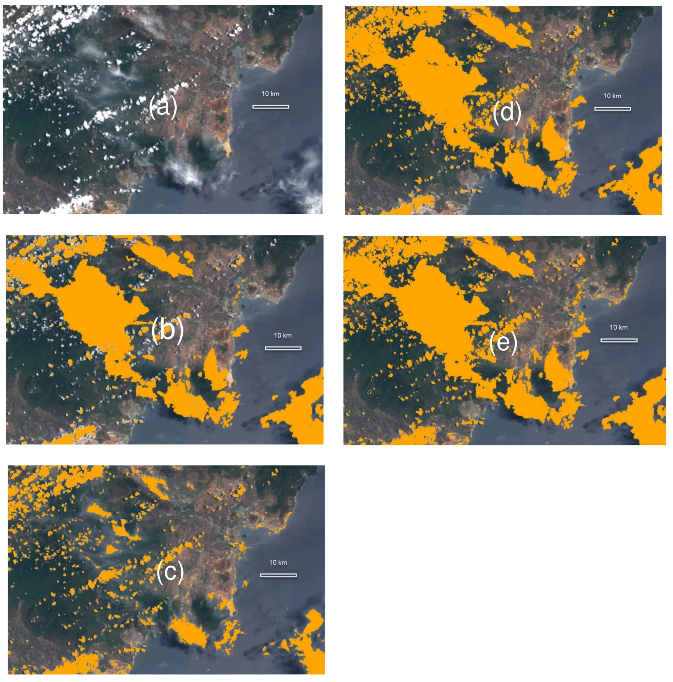
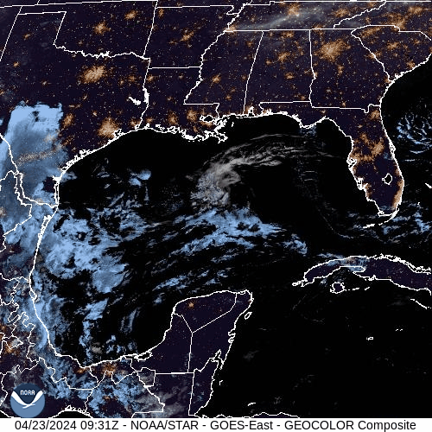
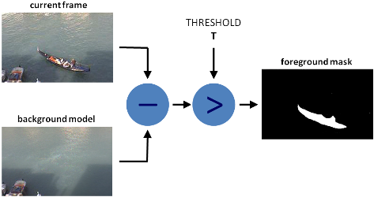
Cloud Extraction
Additive Masking vs Background Subtraction
Building a background would prove difficult and time intensive
Notes:
Image Credits:
https://www.star.nesdis.noaa.gov/goes/fulldisk.php?sat=G16
https://medium.com/@priyanshigupta20/background-substraction-8c2dbdffcf95

Slide 13
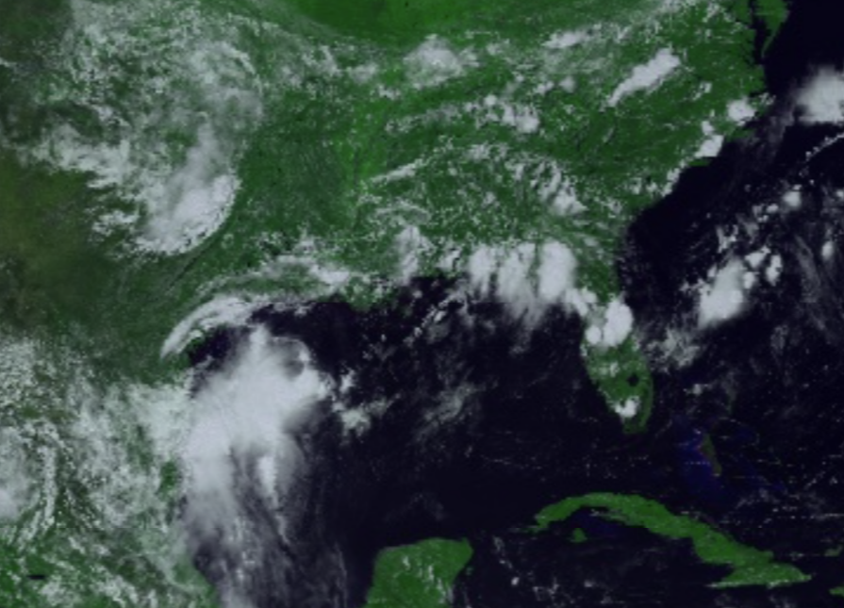
Image Bands
Three Types of Bands:
Visible (450 - 690 nm)
Near-Infrared (846 nm - 2.275 µm)
Infrared (3.80 - 13.6 µm)
Notes:
Image Credit: NOAA GOES Dataset

Slide 14
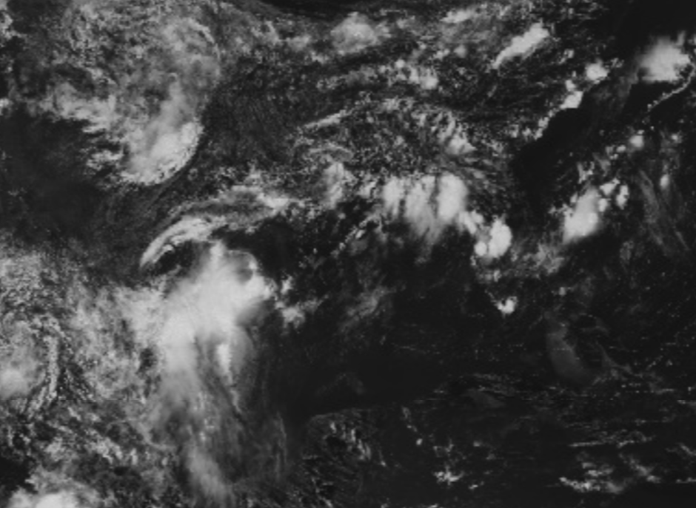
Visible Bands: Visual Blue

Slide 15
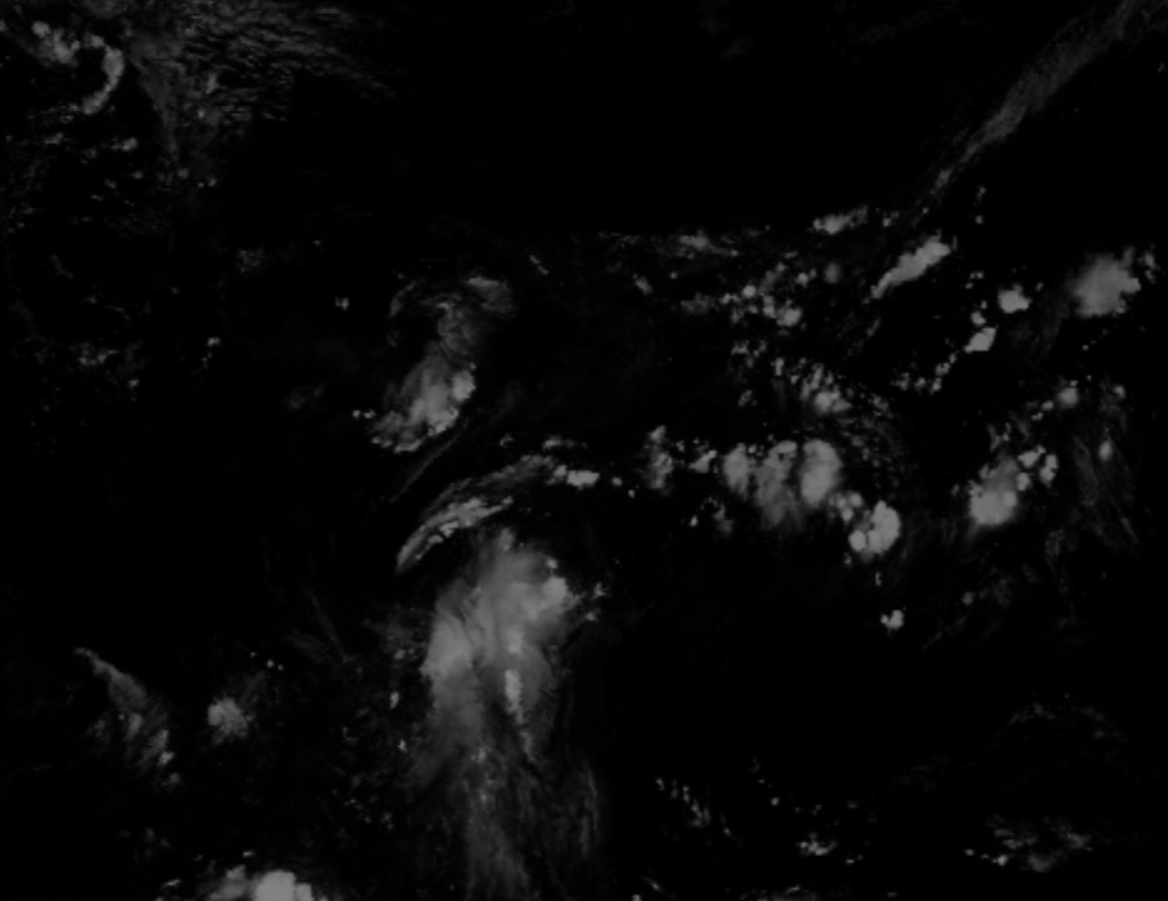
Near-Infrared Bands: Cirrus

Slide 16
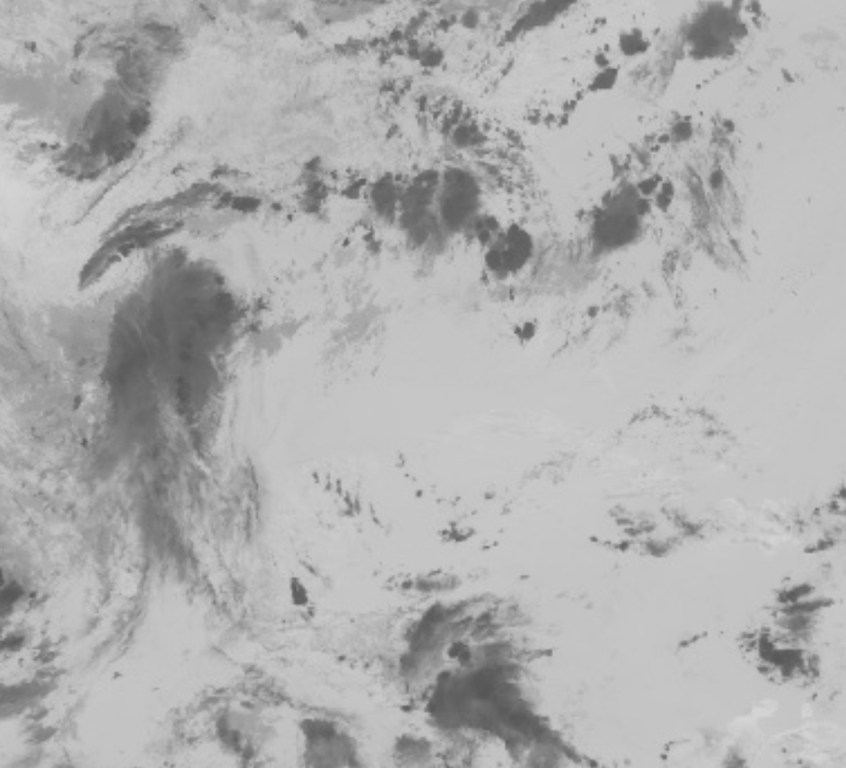
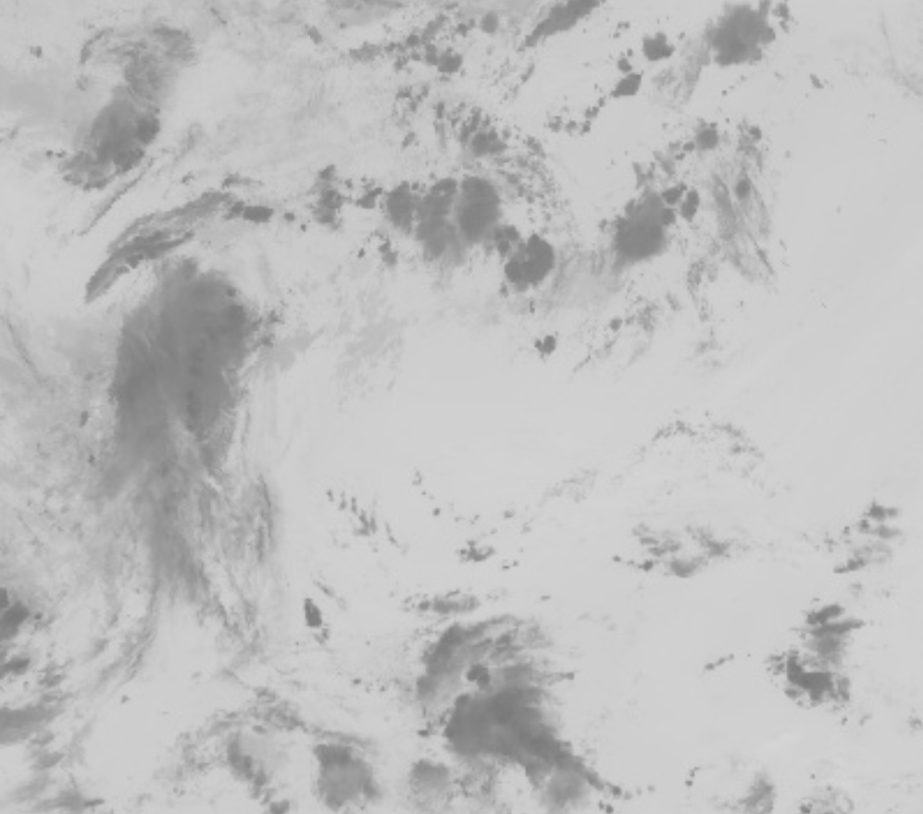
Infrared Bands: Cloud Top Phase, CO2 Longwave

Slide 17
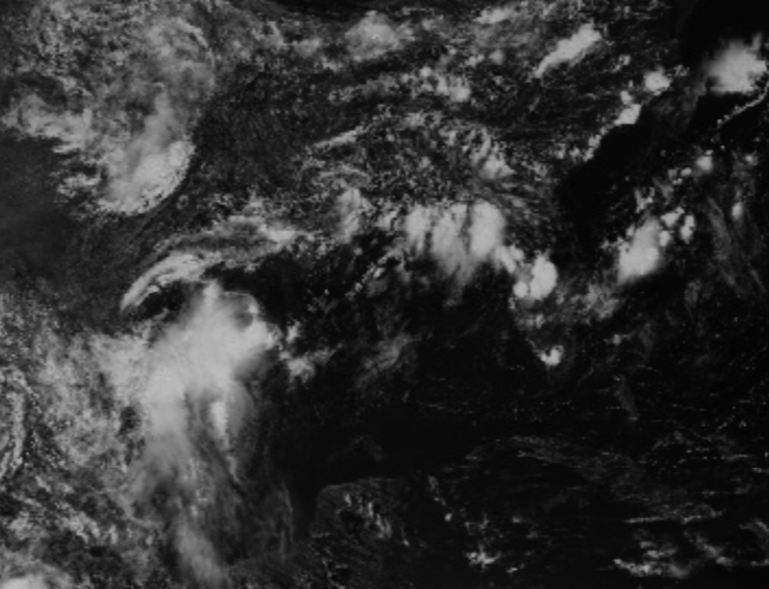
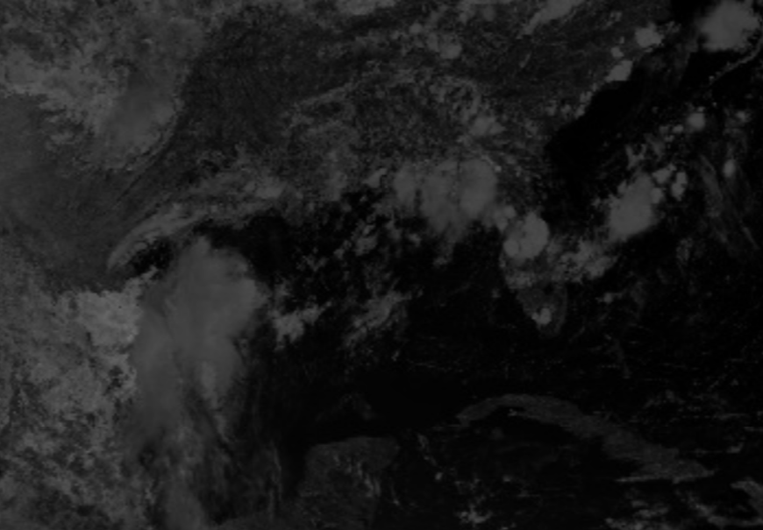
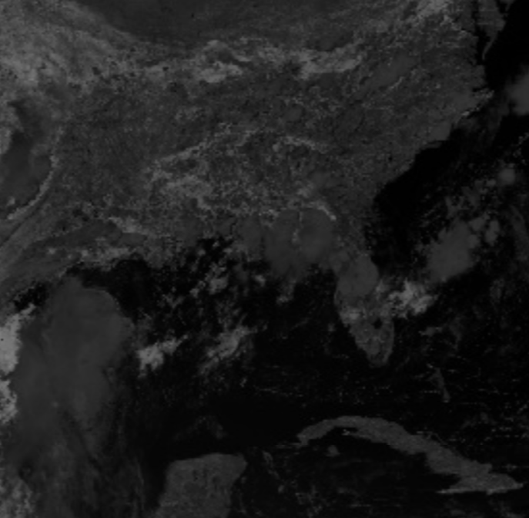
Visual: Red
Near-IR: Cloud Particle Size
Near-IR: Snow/Ice
Undemonstrated Bands

Slide 18
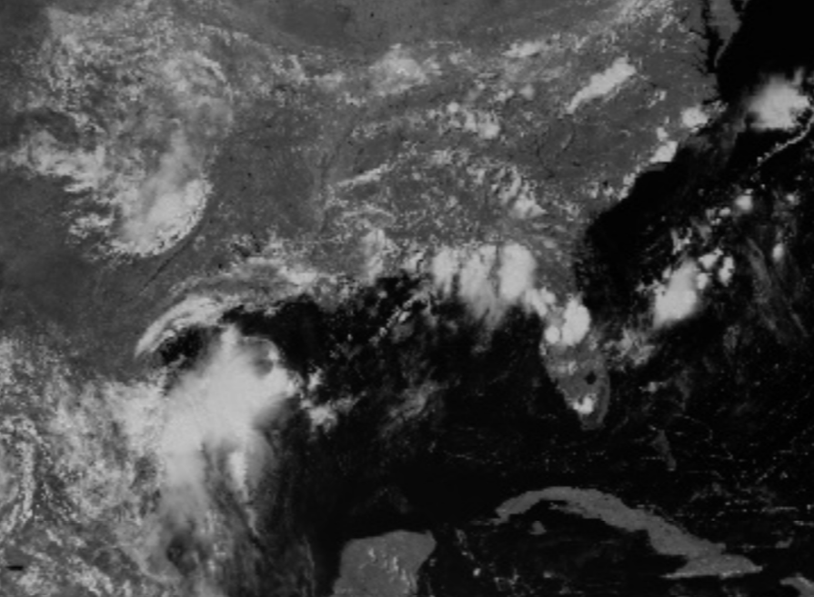
Near-IR: Cirrus
Near-IR: Veggie
Near-IR: Snow/Ice
Undemonstrated Bands

Slide 19
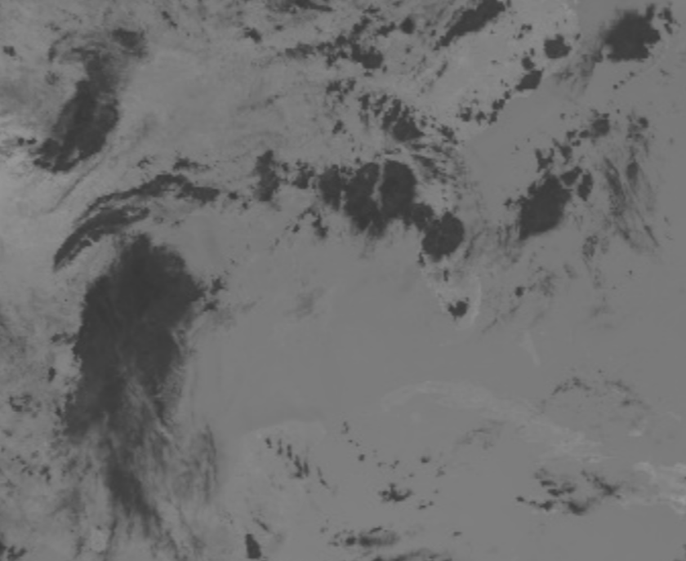
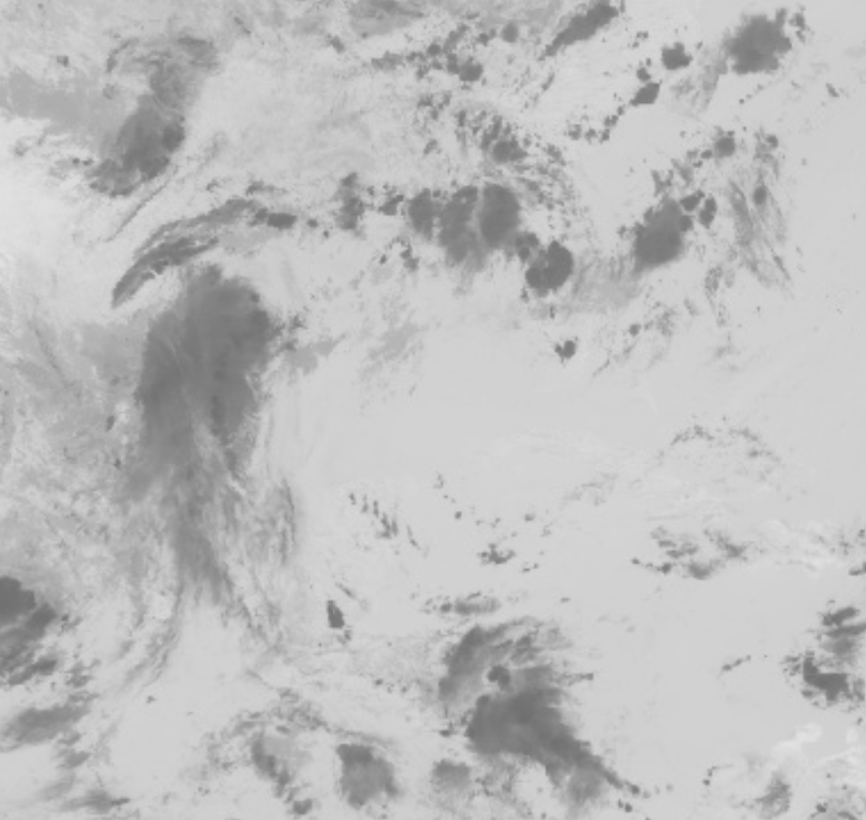
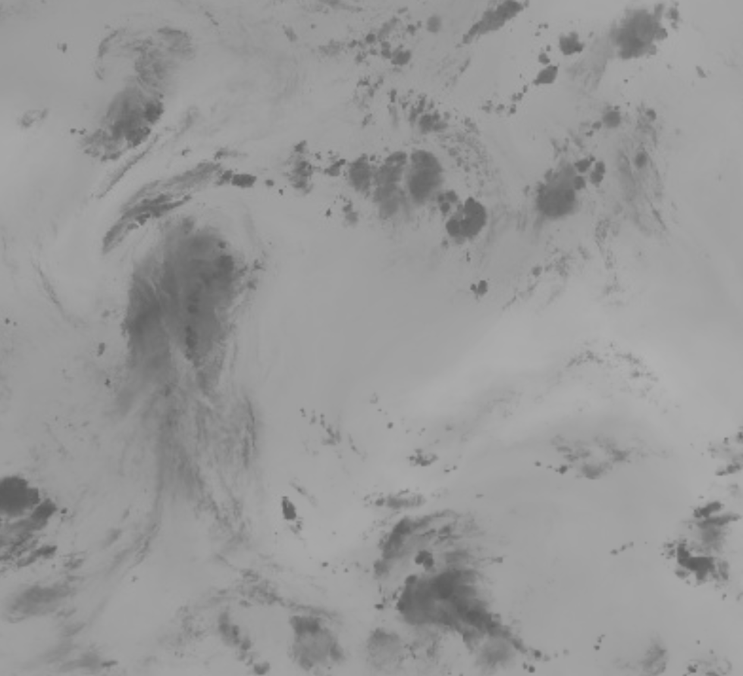
IR: Shortwave
IR: Longwave
IR: Water Vapor
Undemonstrated Bands

Slide 20
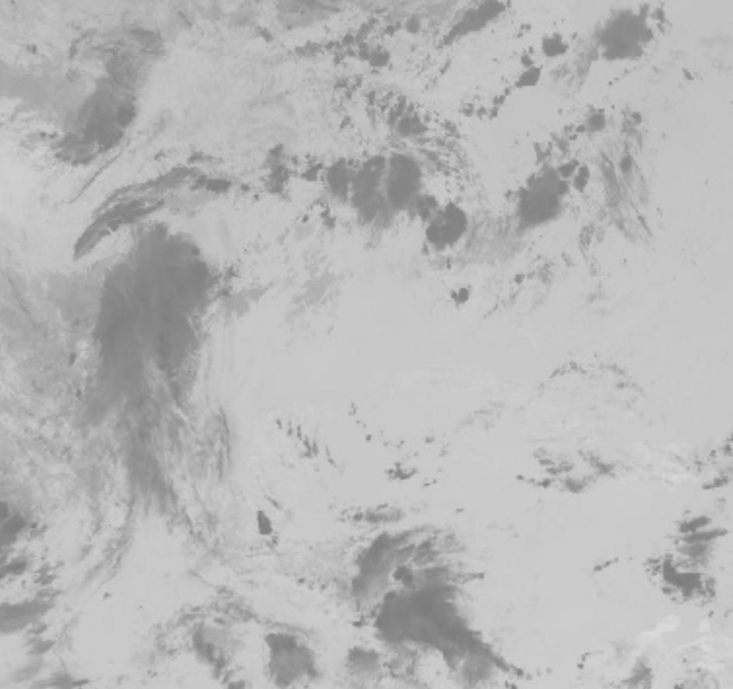
IR: Shortwave
IR: Ozone
IR: Water Vapor
Undemonstrated Bands

Slide 21
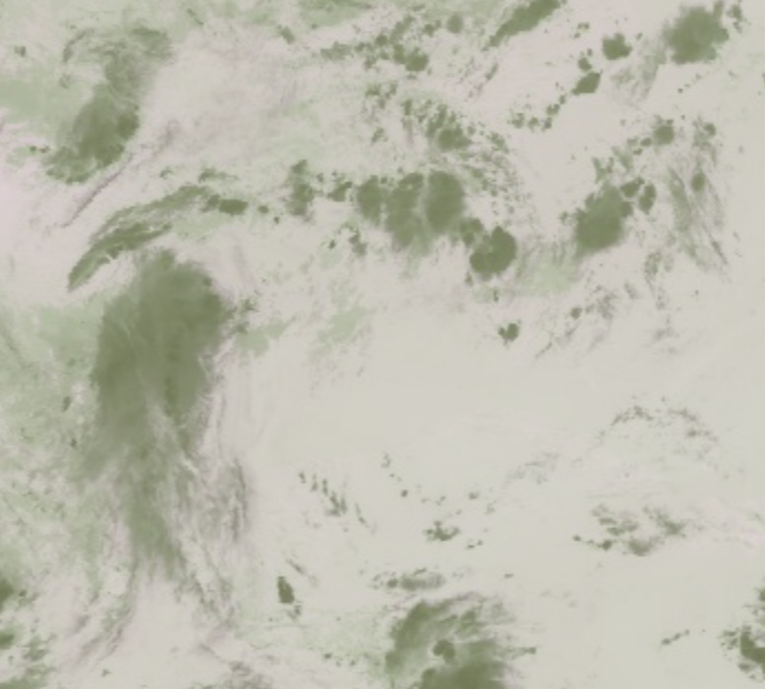
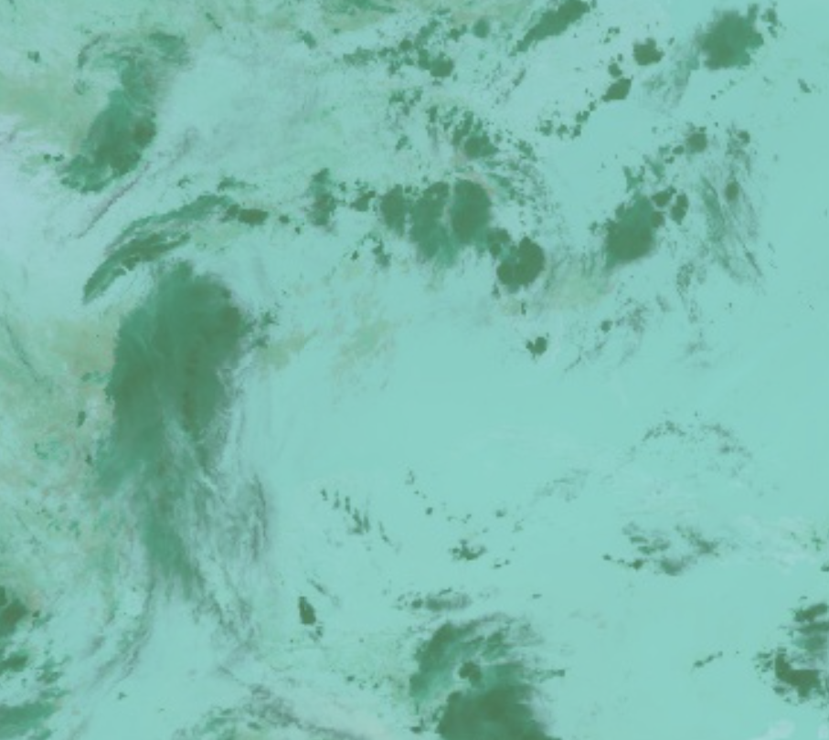
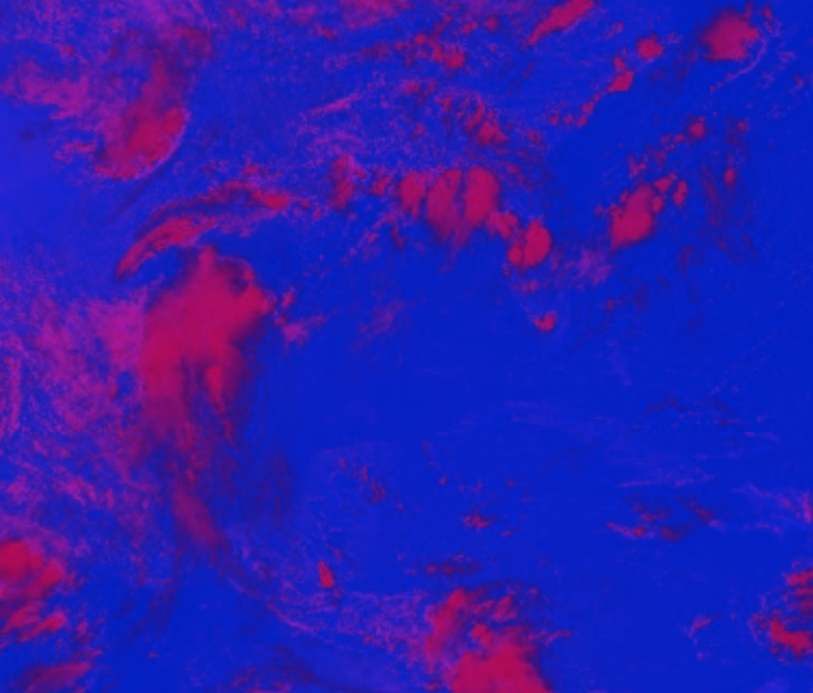
Longwave, CO2, Cloud-top phase
Shortwave, CO2, Cloud-top phase
Visible Red, Cloud-top phase
Tested Combinations

Slide 22
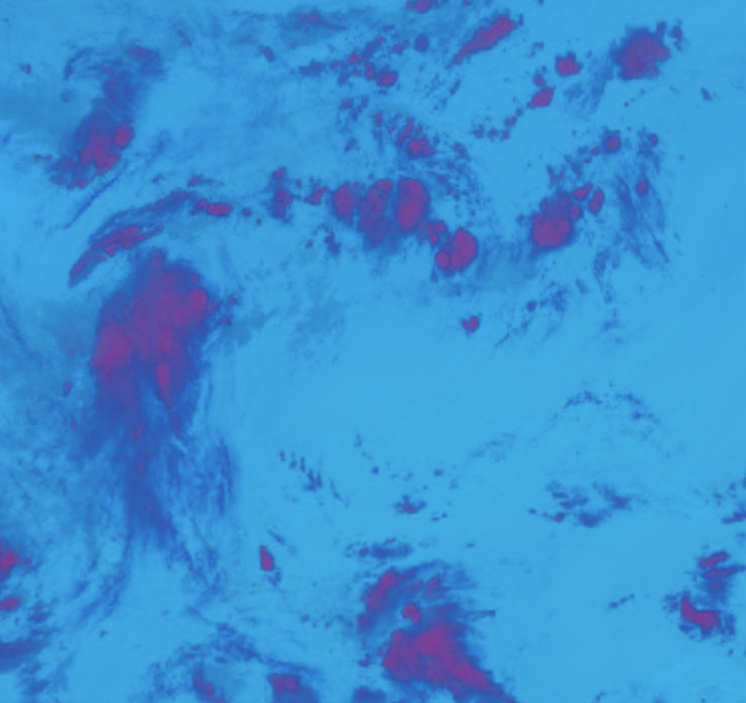
Our Banding Approach
Cirrus, Cloud Phase, CO2 Longwave
Near-IR Cirrus: Great for excluding land and able to see cirrus clouds, but can only see daytime clouds
IR Cloud-Top Phase: Can see clouds at any time and get the general shape of each cloud
IR CO2 Longwave: Able to differentiate clouds by height and aid in night time cloud detection

Slide 23
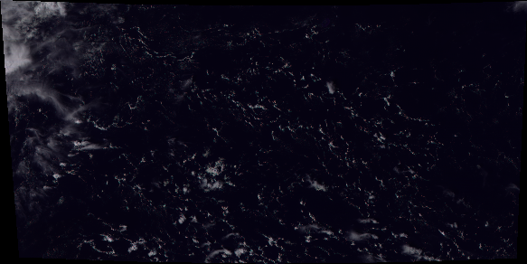

RGB Satellite Image
Grayscale Cloud Mask
Cloud Extraction Output

Slide 24
Data Pipeline
GOES East Images
Receive GOES East images
Banding and Thresholding
Apply Banding and Thresholding
+
Export image and convert image to usable format for Keras
Cloud PNGs
Input image(s) into movement prediction model
Movement Prediction

Slide 25
Movement Prediction Models

Slide 26
Initial Approaches
Traditional autoregressive model seemed to be ineffective for filling in the image data between GOES satellite screenshots
AR models typically used for time-series numerical data
Similarly, LSTMs on their own were not usable for the project due to our needs for spatial processing
Possible alternatives could involve the output of such models into CNNs or RNNs

Slide 27
Convolution Model
One input frame to one output frame
1
32
64
1

Slide 28
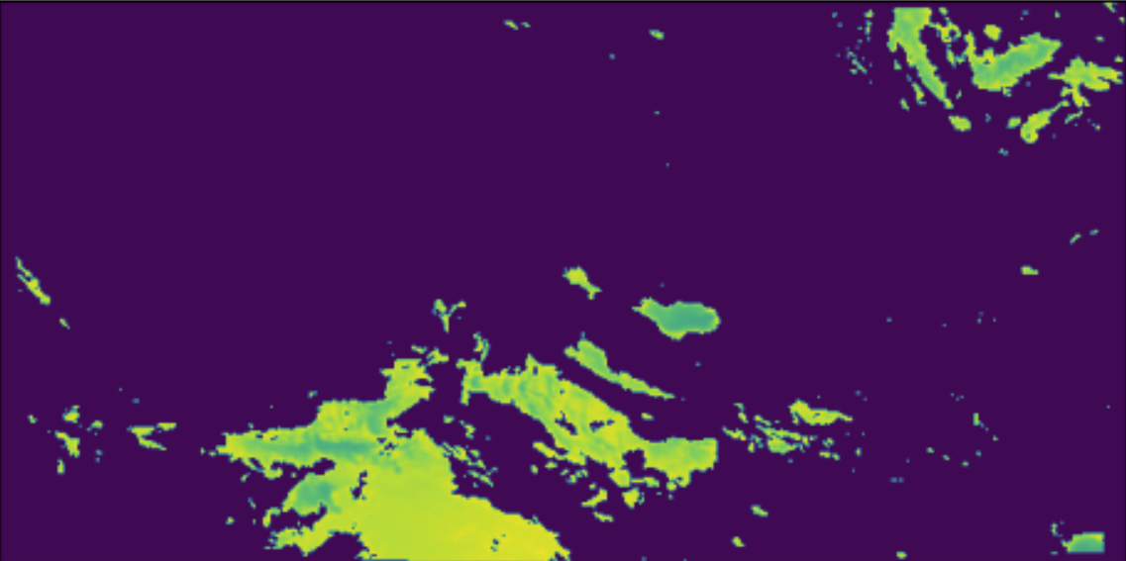
Convolutional Model Results: Single Predictions
Input Frame

Slide 29
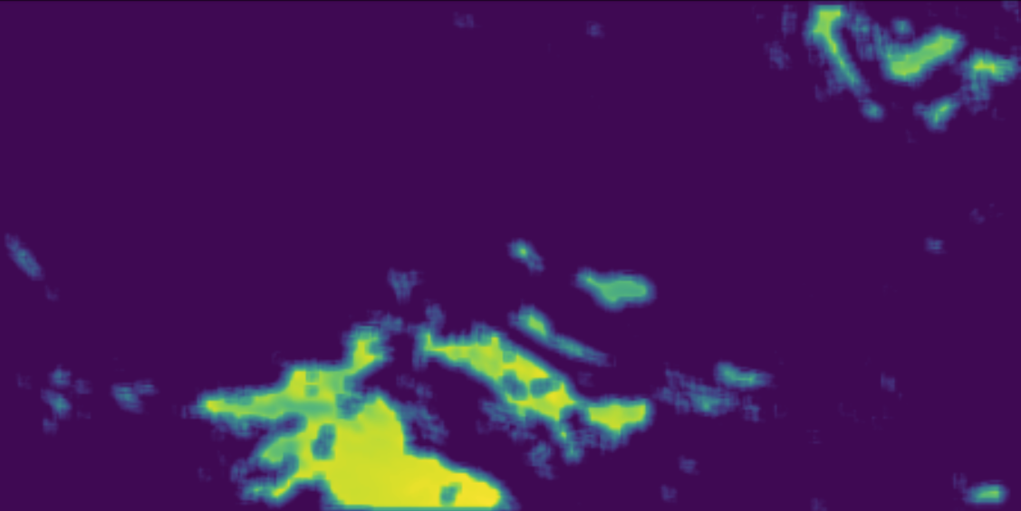
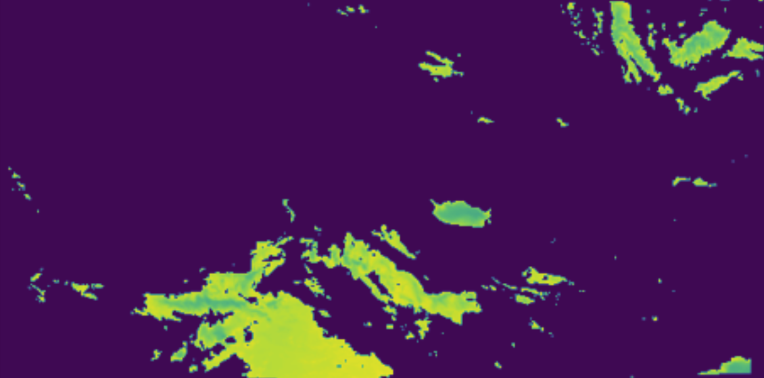
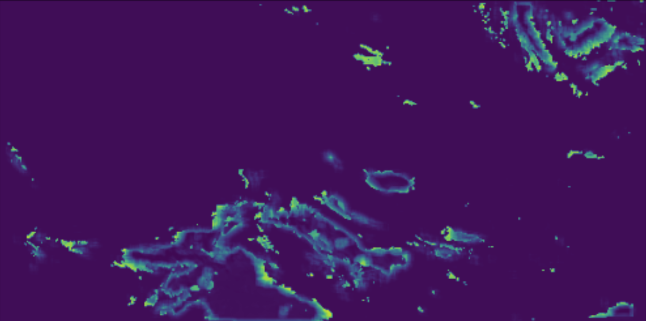
Predicted Frame
Expected Output
Squared Error

Slide 30

Convolutional Model Results: Consecutive Predictions
Expected Output

Slide 31

Convolutional Model Results: Consecutive Predictions
Predictions

Slide 32
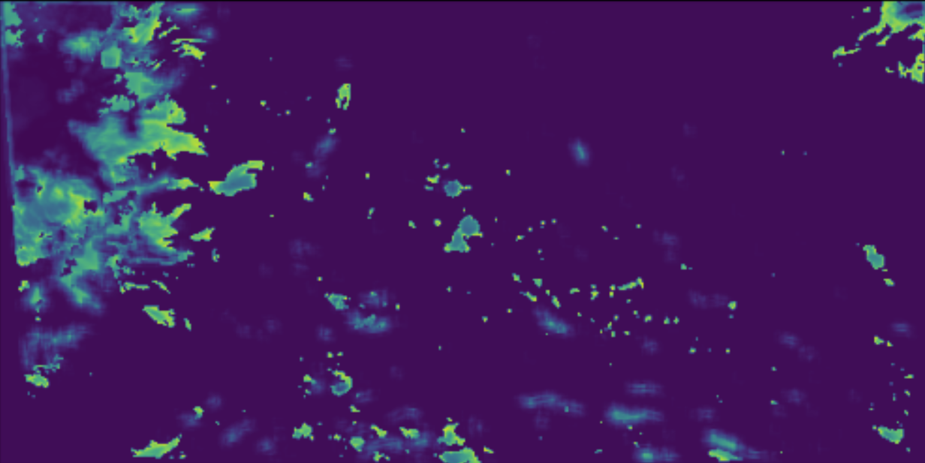
Convolutional Model Results: Consecutive Predictions
Mean Squared Error (predictions, expected)

Slide 33
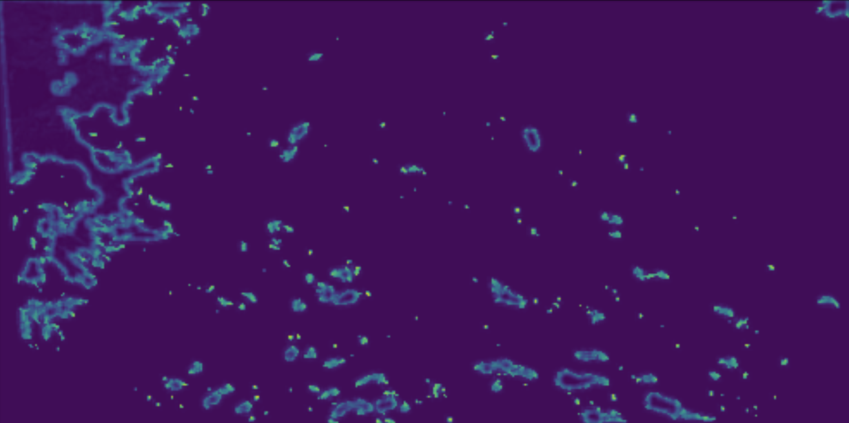
Convolutional Model Results: Consecutive Predictions
Squared Error (predictions[-1], input)

Slide 34
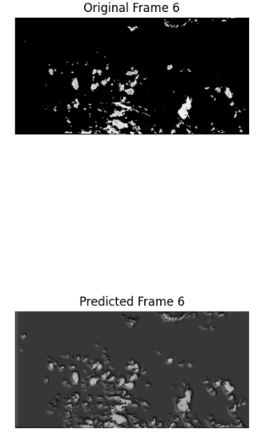
Convolutional Long Short-Term Memory Model
Shows promise, effective at capturing general movements and changes over
Struggles with rapid atmospheric changes due to their sequential data processing nature
Clouds dissipating, forming
Temporal smoothing inherent in LSTM blurs distinctions between different stages of cloud dynamics, producing averaged or smoothed predictions

Slide 35
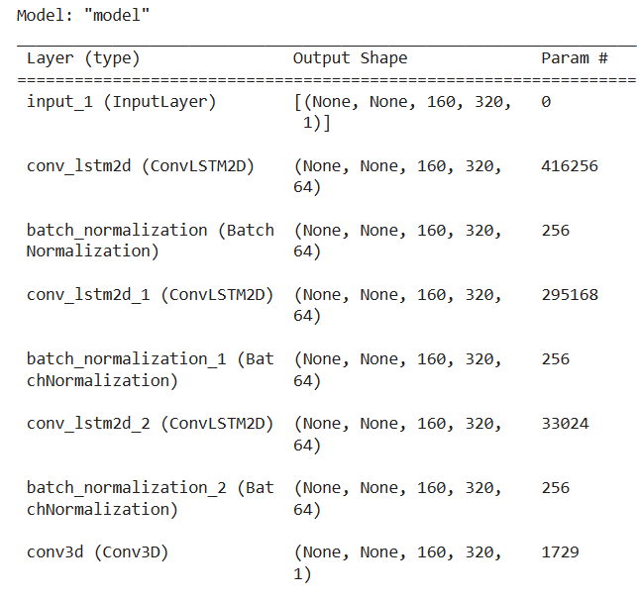
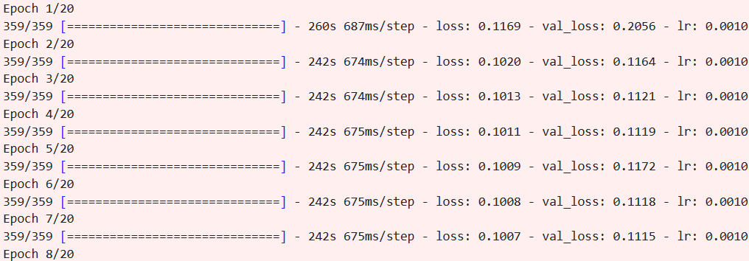
Convolutional Long Short-Term Memory Model

Slide 36
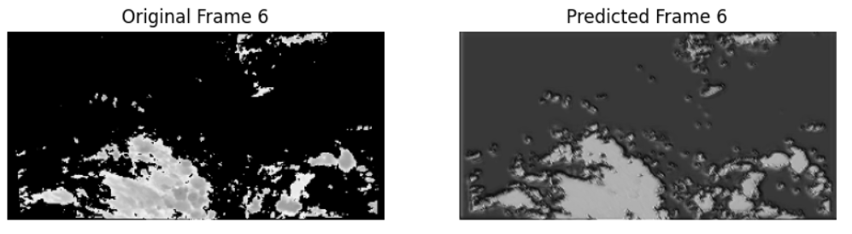
Convolutional Long Short-Term Memory Model

Slide 37
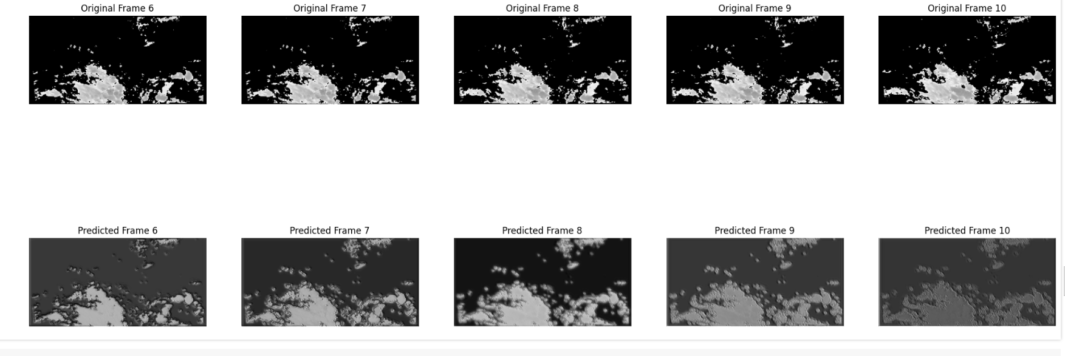
Convolutional Long Short-Term Memory Model

Slide 38
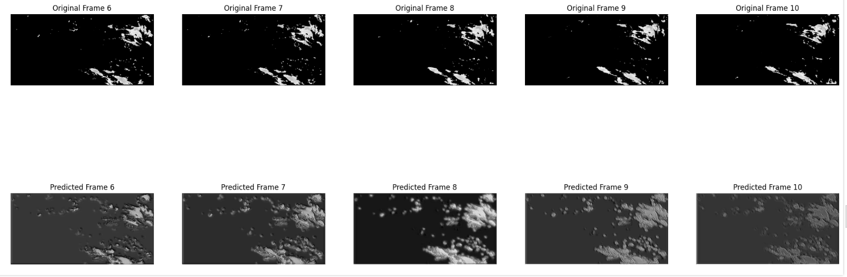
Convolutional Long Short-Term Memory Model

Slide 39
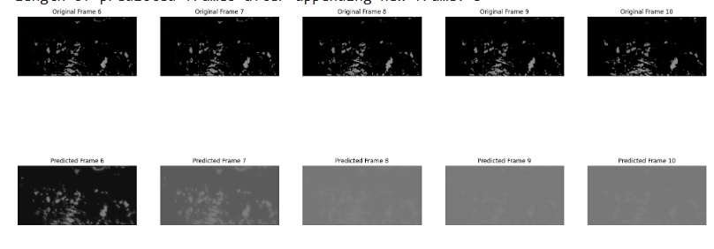
Convolutional Long Short-Term Memory Model

Slide 40
Data Pipeline
GOES East Images
Receive GOES East images
Banding and Thresholding
Apply Banding and Thresholding
+
Export image and convert image to usable format for Keras
Cloud PNGs
Input image(s) into Convolutional LSTM
Reduce required number of predictions
Convolutional LSTM

Slide 41
Data Pipeline
GOES East Images
Receive GOES East images
Banding and Thresholding
Apply Banding and Thresholding
+
Export image and convert image to usable format for Keras
Cloud PNGs
Input image(s) into Convolutional LSTM
Reduce required number of predictions
Input combination of images and predictions into gap-filling model
Convolutional LSTM
Gap-Filler

Slide 42
Models to Fill Data Gaps

Slide 43
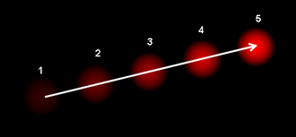
Optical Flow
Motion in image processing defined in three ways:
Changes in light
Changes in an object
Changes in the camera
Notes:
Image Credits: https://en.wikipedia.org/wiki/Optical_flow (Accessed May 2024)

Slide 44
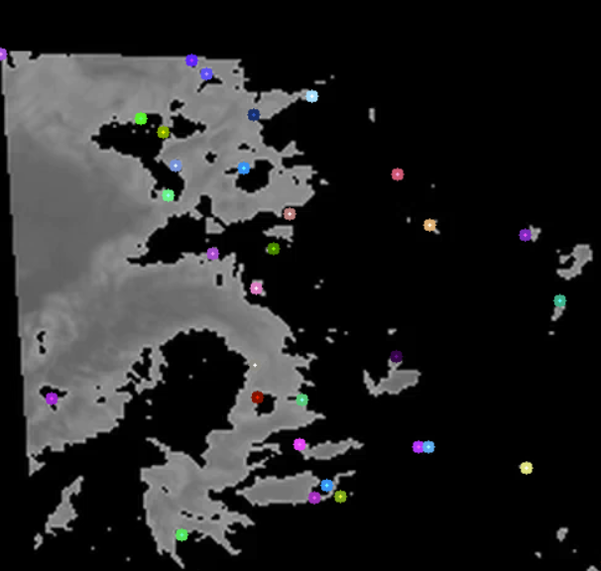
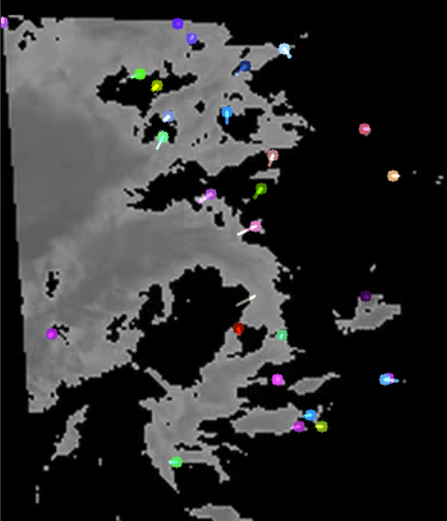
Optical Flow via OpenCV

Slide 45
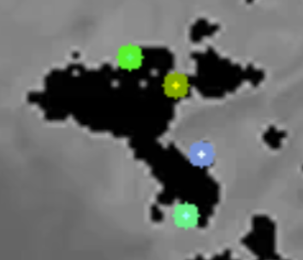
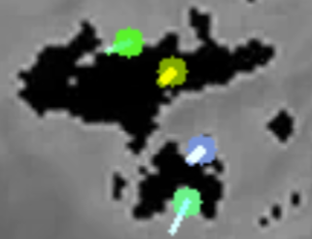
Optical Flow Issues
3 variables (clouds shape, lighting, earth rotating)
Images too far apart in time (15 minutes vs. 33ms)
Optical Flow not meant for fluids

Slide 46
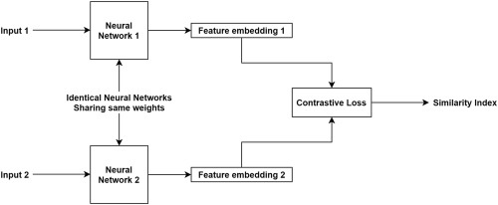
Siamese Network
Two input frames to one output frame
Notes:
Image Credits: https://www.sciencedirect.com/science/article/pii/B9780128226889000153

Slide 47
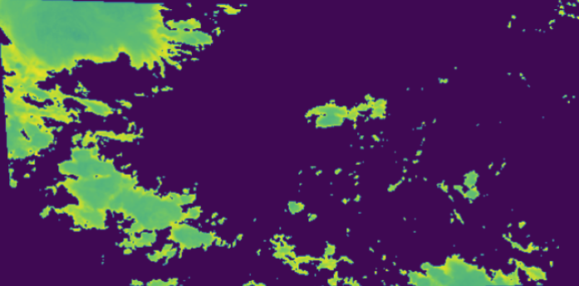
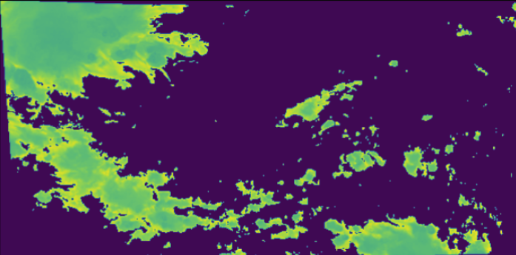
Siamese Model Results: Single Predictions
Starting Frame
Ending Frame

Slide 48
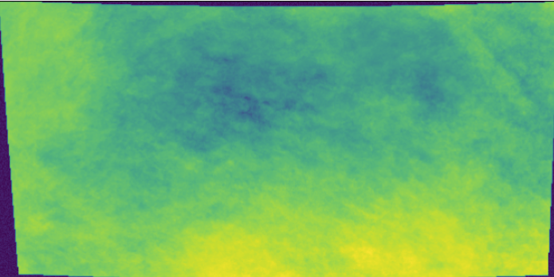


Predicted Frame
Expected Output
Squared Error

Slide 49

Siamese Model: What is Possible
Peng Lei, Fuxin Li, and Sinisa Todorovic (2018)

Slide 50

Siamese Model: What is Possible
Peng Lei, Fuxin Li, and Sinisa Todorovic (2018)

Slide 51

U-Net Frame Interpolation
Two input frames to one output frame
Notes:
Image Credits: https://github.com/neil454/deep-motion?tab=readme-ov-file

Slide 52


U-Net Model Results: Single Predictions
Starting Frame
Ending Frame

Slide 53



Predicted Frame
Expected Output
Squared Error

Slide 54

U-Net Model Results: Consecutive Predictions
Expected Output

Slide 55

U-Net Model Results: Consecutive Predictions
Predictions

Slide 56

U-Net Model Results: Consecutive Predictions
Expected Output

Slide 57

U-Net Model Results: Consecutive Predictions
Predictions

Slide 58
Final Data Pipeline
GOES East Images
Receive GOES East images
Banding and Thresholding
Apply Banding and Thresholding
+
Export image and convert image to usable format for Keras
Cloud PNGs
Input image(s) into Convolutional LSTM
Reduce required number of predictions
Input combination of images and predictions into U-Net to fill gaps
Convolutional LSTM
U-Net

Slide 59
With More Time
Train ConvLSTM with a custom loss function that discourages “whiting out” the background to compensate for cloud dissipations
Additional ConvLSTM layers incorporating new features related to cloud dissipation and formation
Try new normalization techniques for models (integers 0 or 1 instead floats from 0 to 1) or customized loss function to limit blurring of predictions

Slide 60
With More Time
Remodel and continue work on the Siamese architecture
Increase region of interest
Work with more geostationary satellites (Landsat, MODIS, Sentinel)
Alter models to fit RGB images

Slide 61
Questions?

Slide 62
Thank you!

